Slide 1

Project Overview
“HPN” or “Heavy Power Nutrition” USA based sports & bodybuilding products manufacturing company expanded their business to the north American , European & Latin territory .
Task
As a business data analyst at “HPN” task is to provide various business ad-hoc request solution, uncovering insights , trends based on the data we have access to .
Database
MySQL database is to be used for this project .

Slide 2
Project Pipeline
Step 1
Create database
Step 2
Upload CSV files to database
Step 3
Connect My Sql server to excel & proceed further to create explanatory dashboard
Step 4
Apply crude operations to prepare the data
Step 5
Query Ad-Hoc analysis on different scenario provided by management

Slide 3
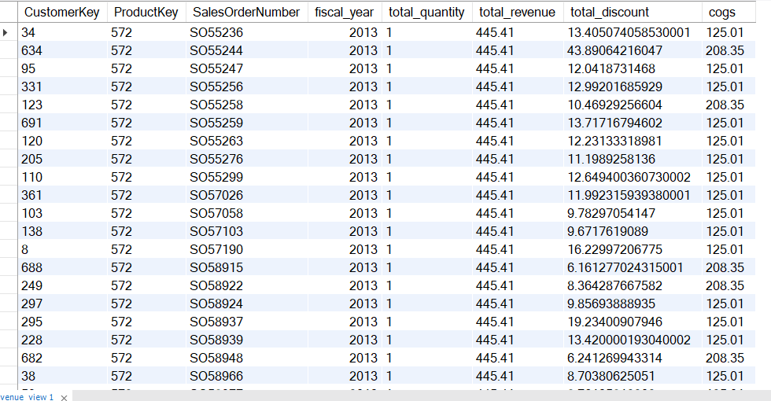
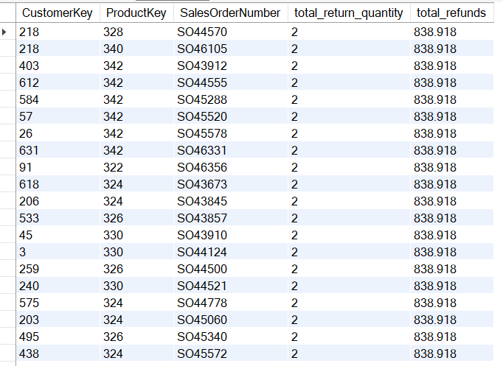
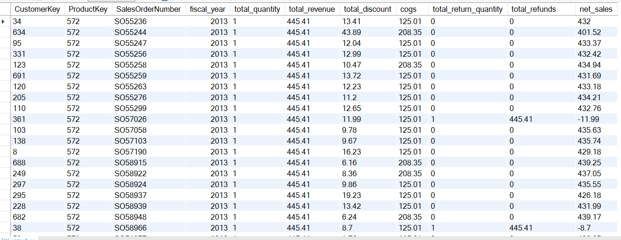
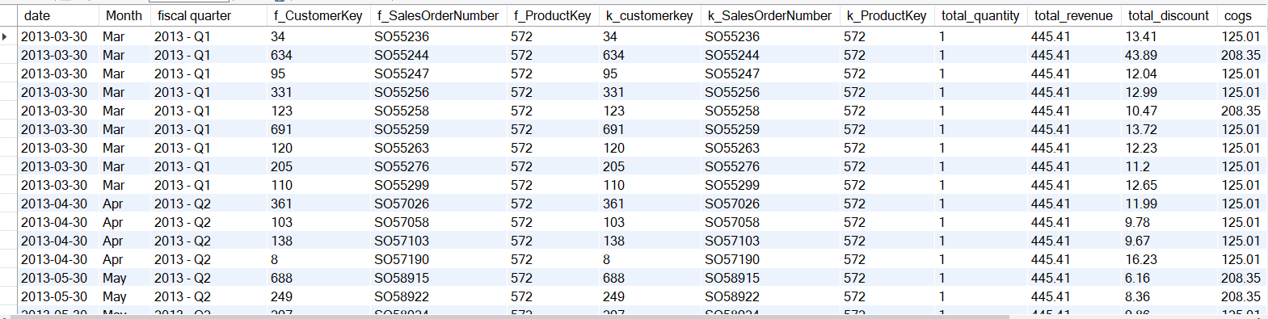
Created 4 Views to do aggreggation based calculation based on date & different parameters
Revenue View
Refunds View
KPI View
Date View

Slide 4

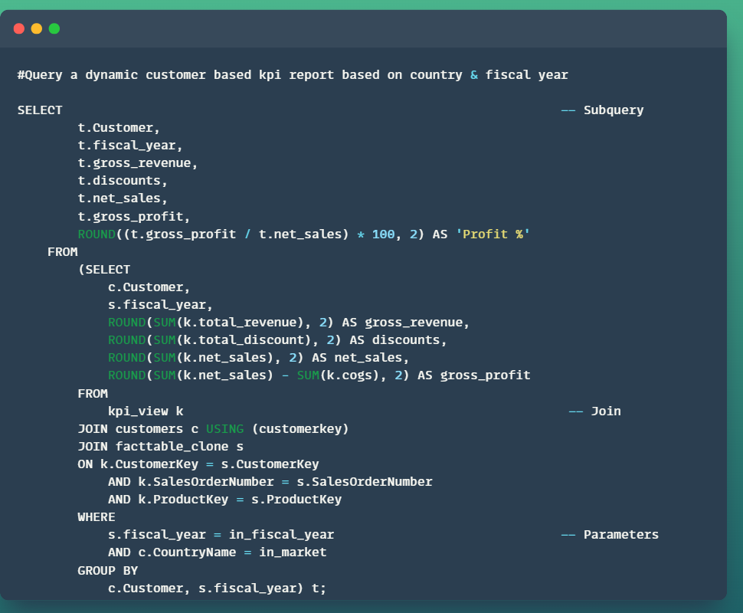
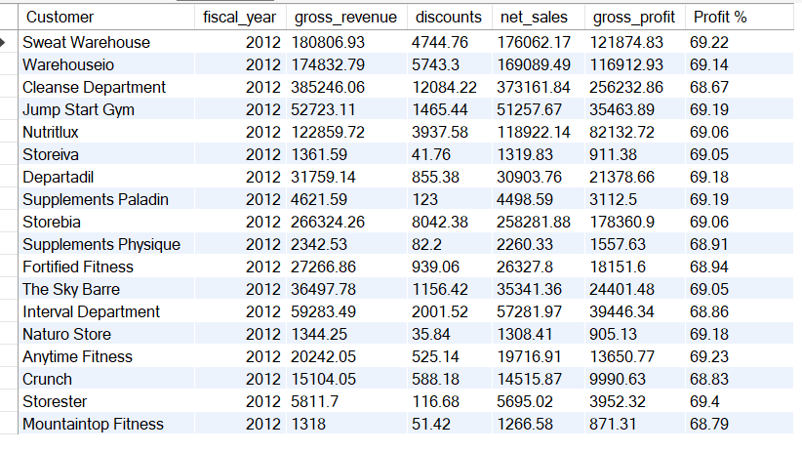
Q: Generate a customer business report with kpi & report must be dynamic based on fiscal year and market.

Slide 5
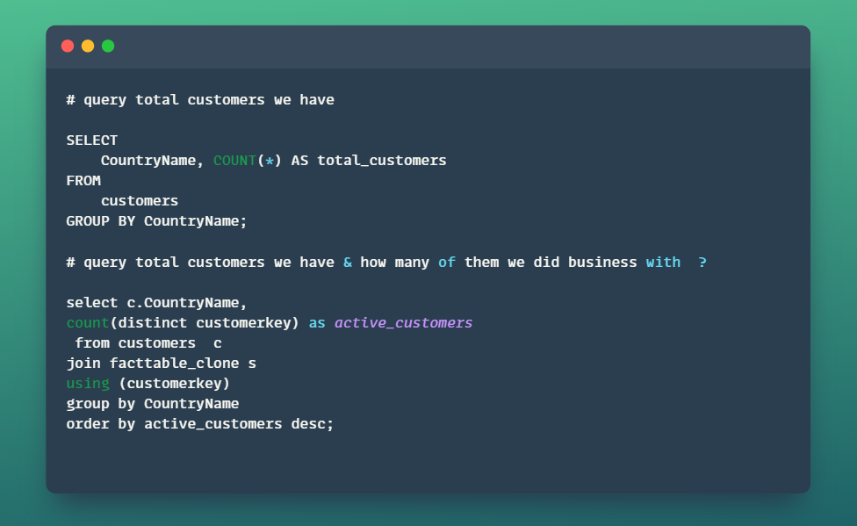
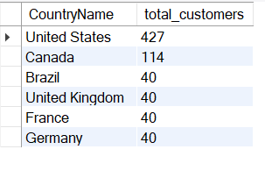
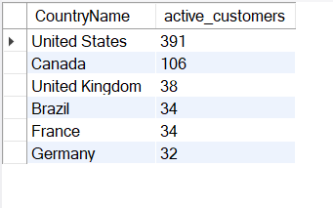
Q: Identify total customers we have & active customers did business with .

Slide 6
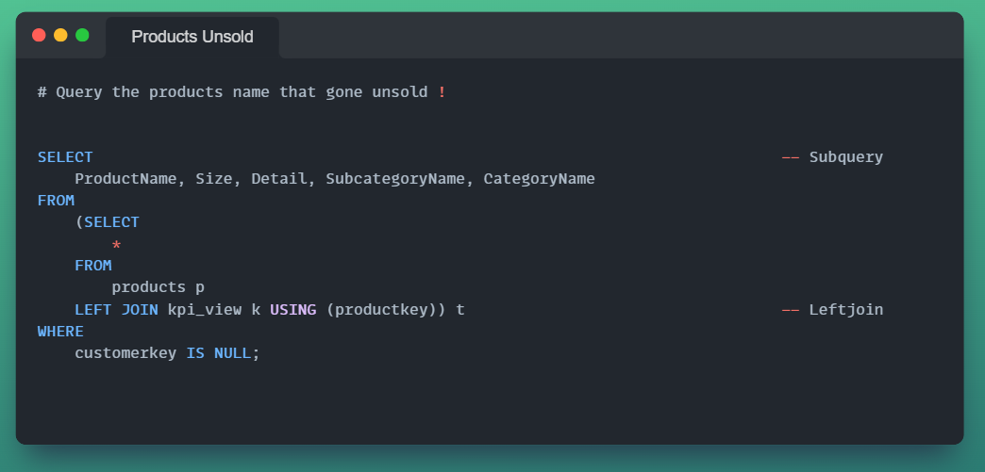
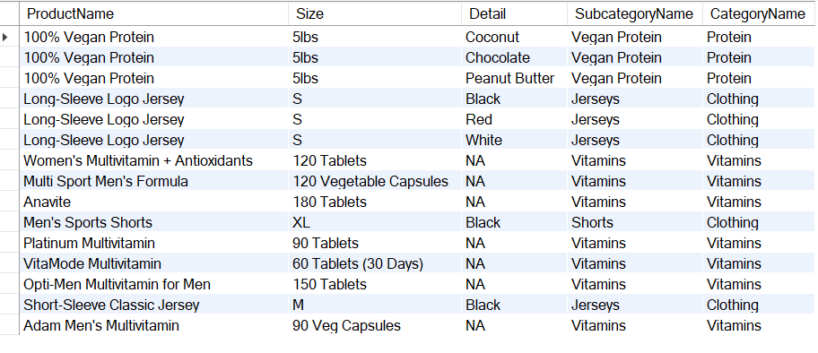
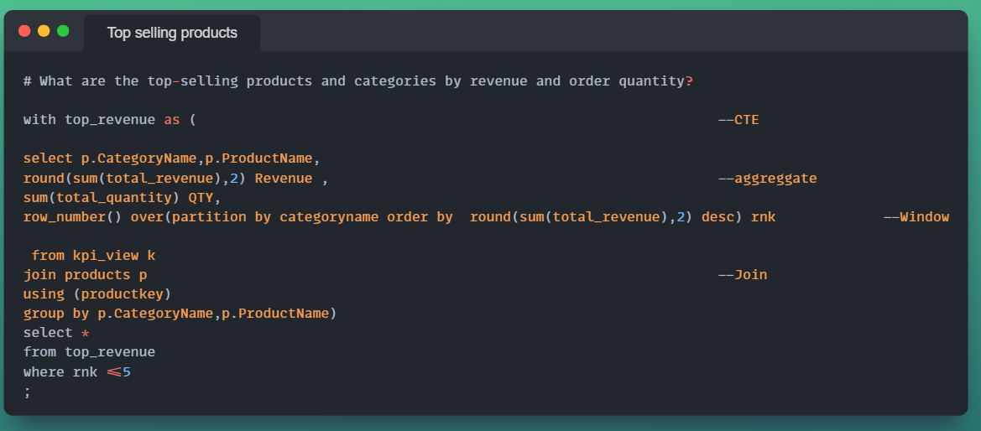
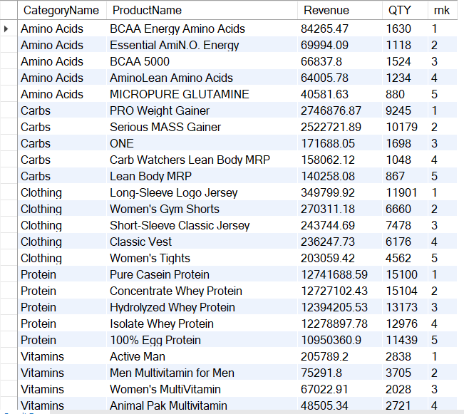
Q: Write query to return top selling products by category & a query to return products that are unsold.

Slide 7
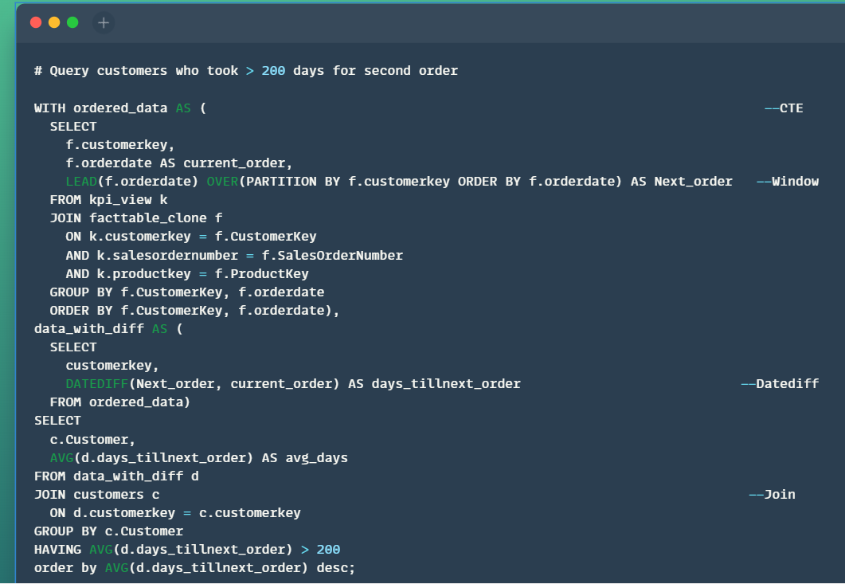
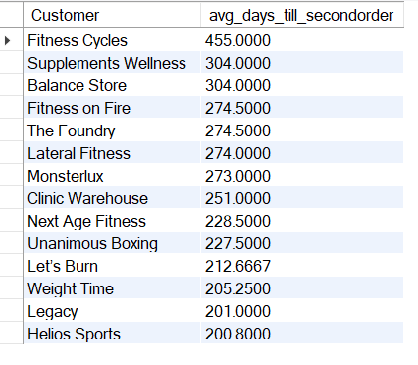
Q: Query the customers who took >200 days for second order.

Slide 8
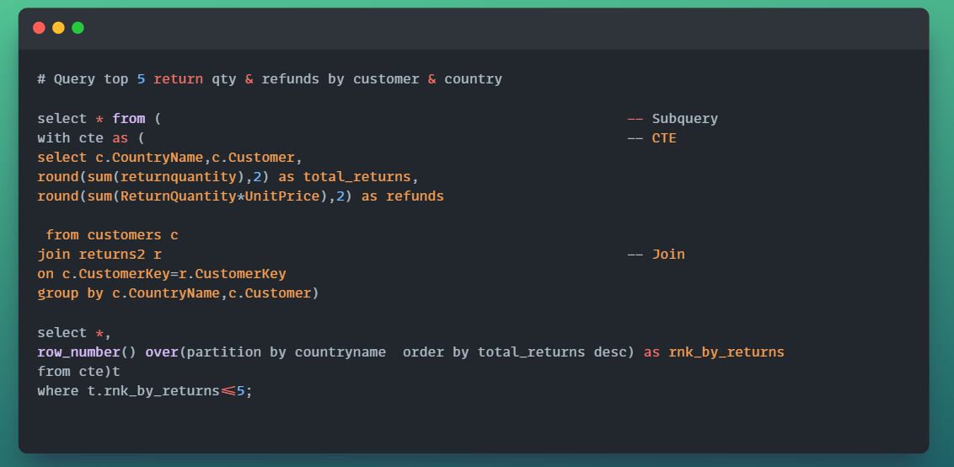
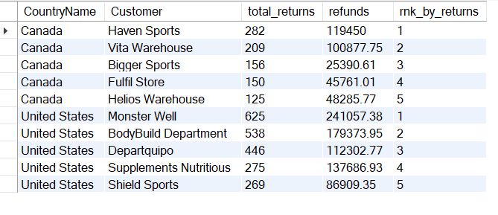
Q: Query country, customer wise top 5 qty returns & amount refunds .

Slide 9
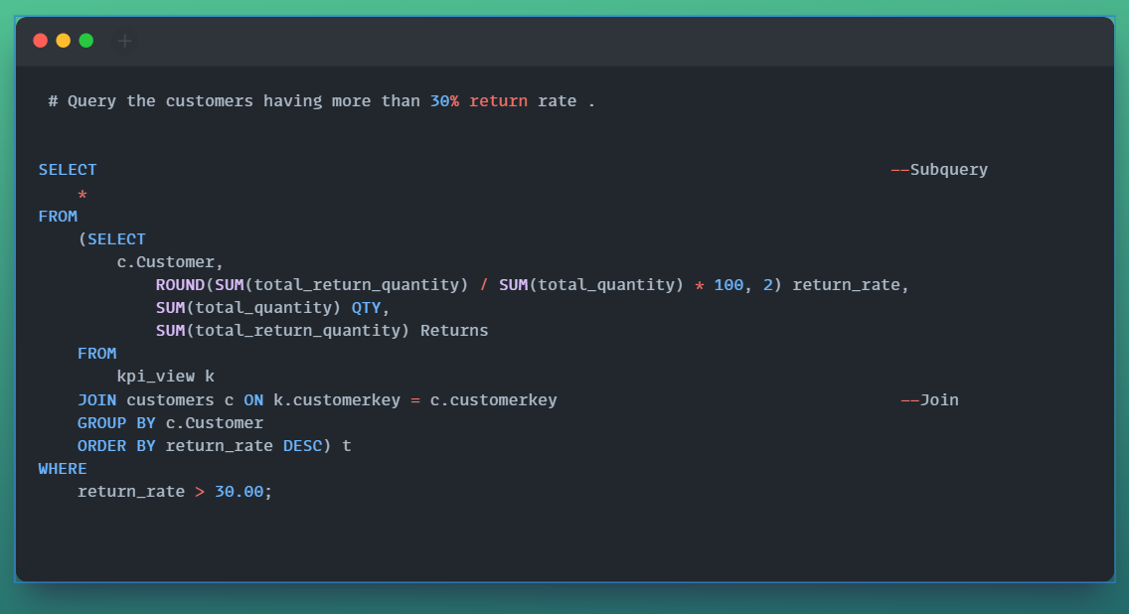
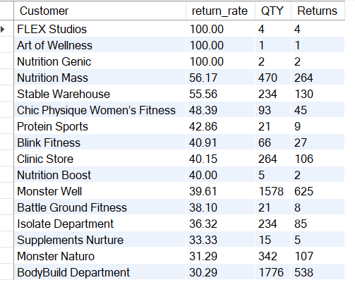
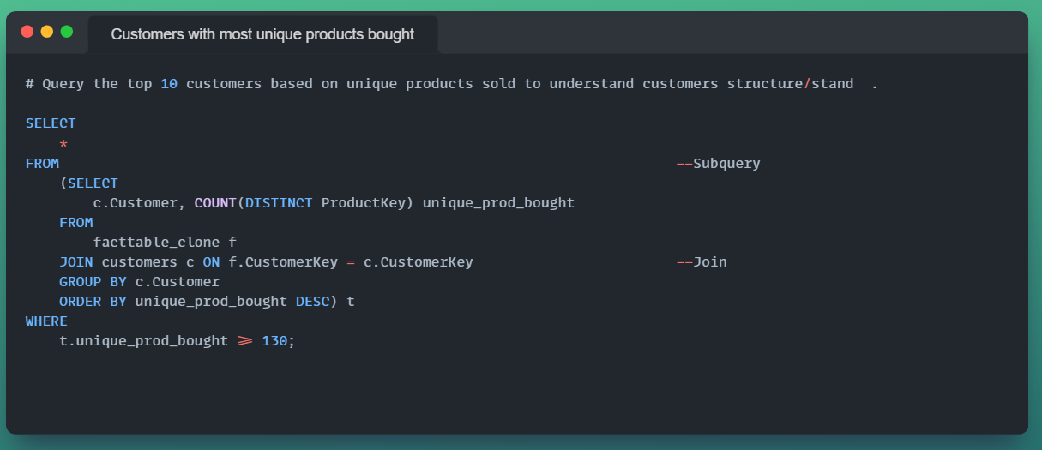
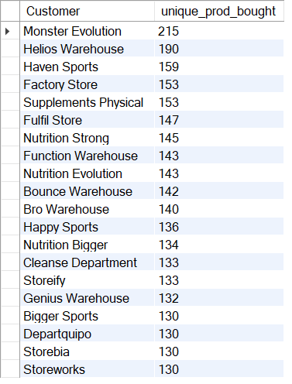
Q: Query customers having return rate > 30% & identify customers who bought most unique products .

Slide 10
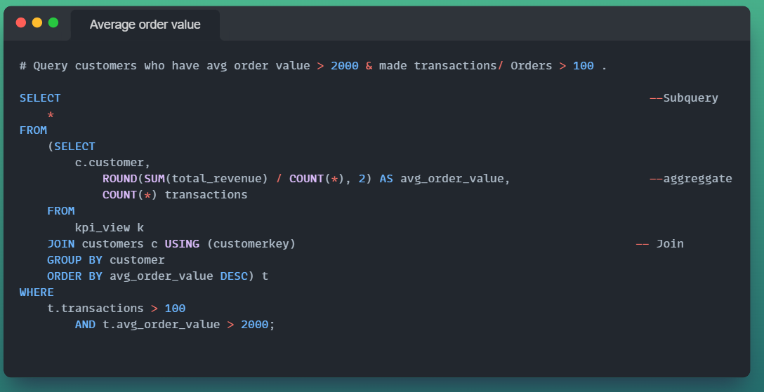
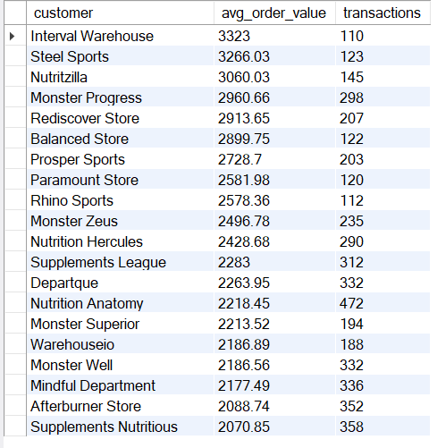
Q: Query avg order value by customers > 2000 & transactions > 100 to identify high spending customers .

Slide 11
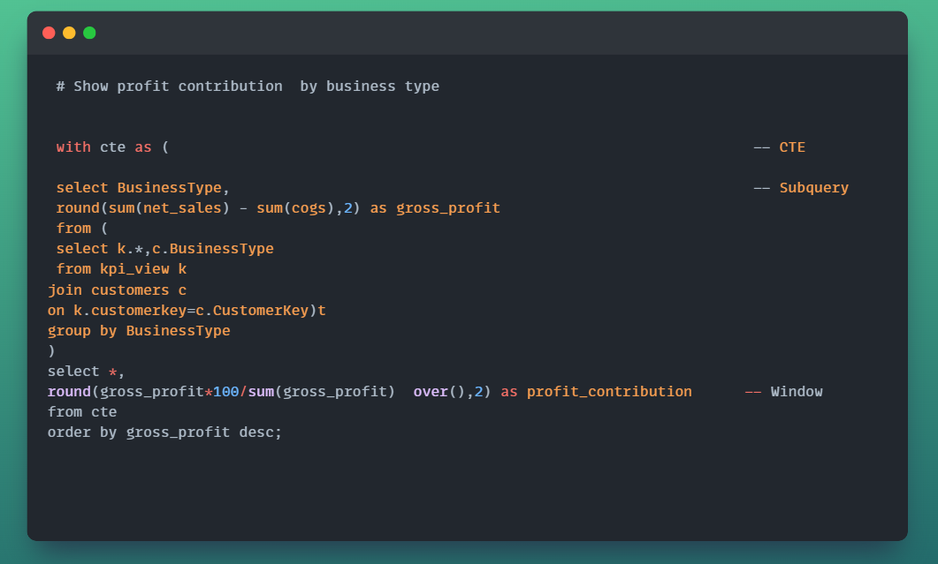
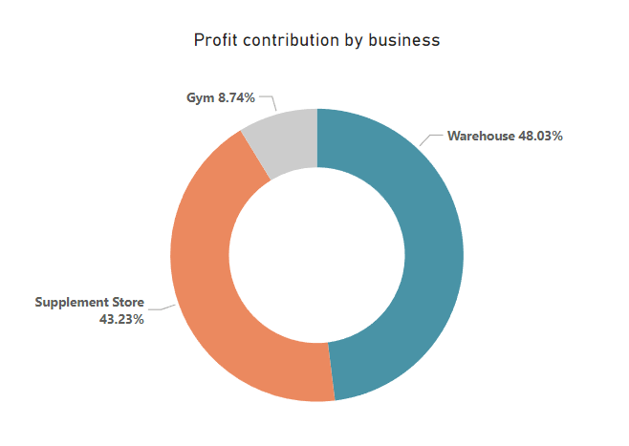
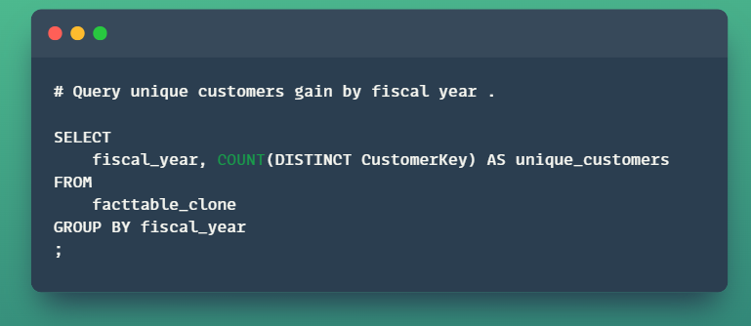
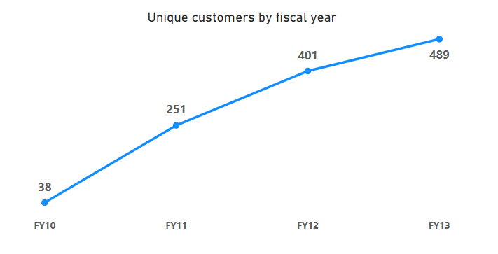
Q:Query profit contribution by business type & unique customers gain by fiscal year

Slide 12
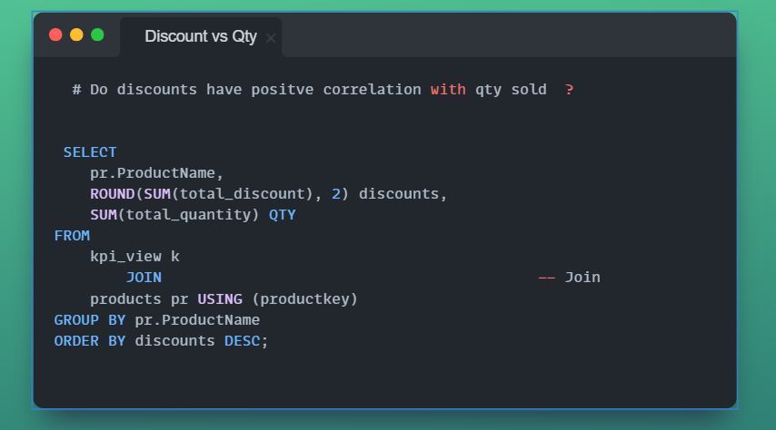
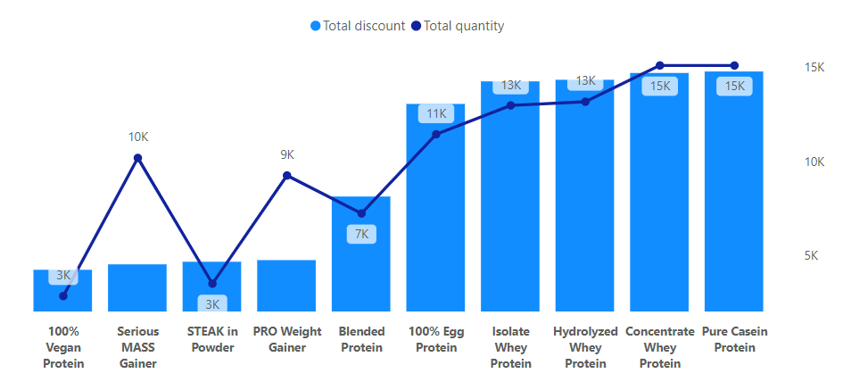
Q: Do discounts have correlation with products qty sold ?

Slide 13
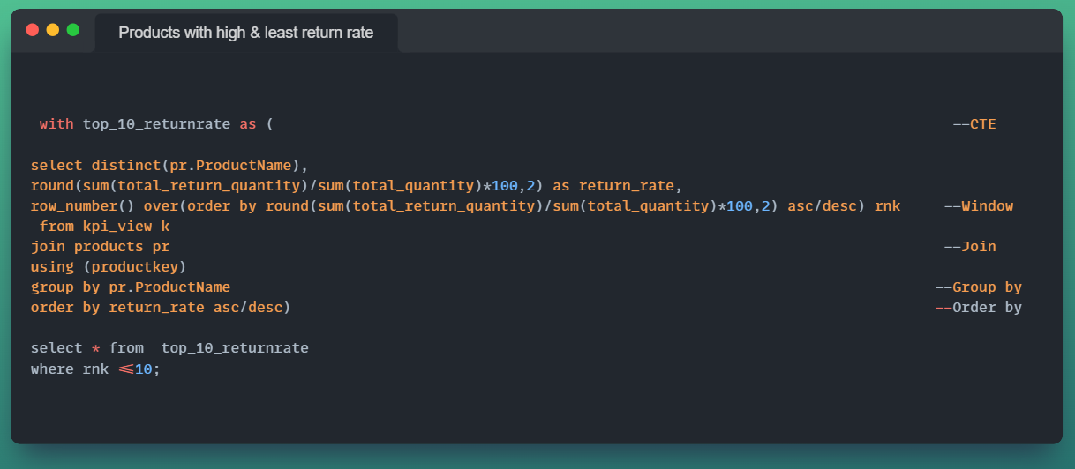
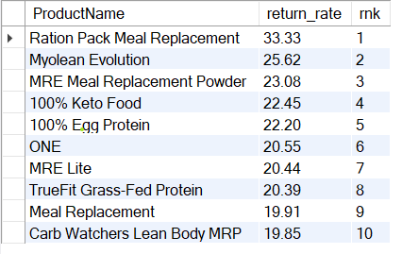
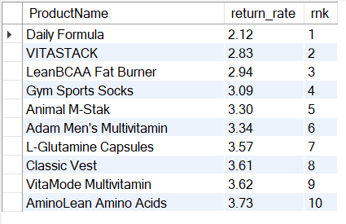
Q:Query top 10 products & least 10 products with return rate

Slide 14
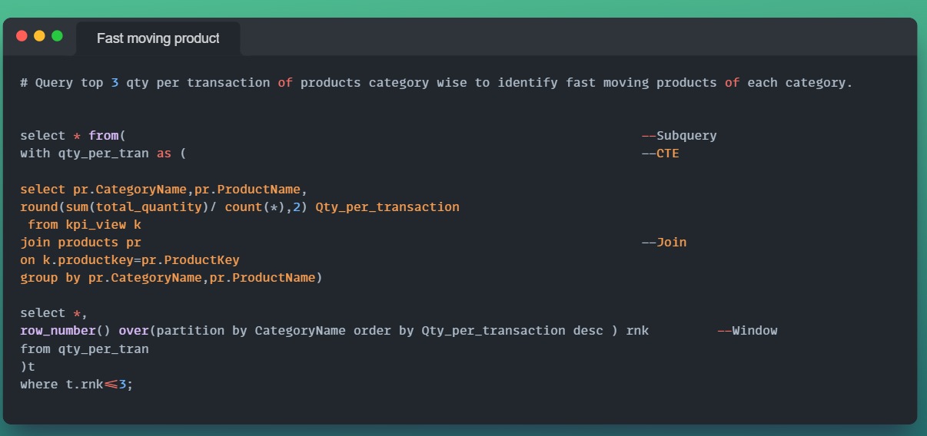
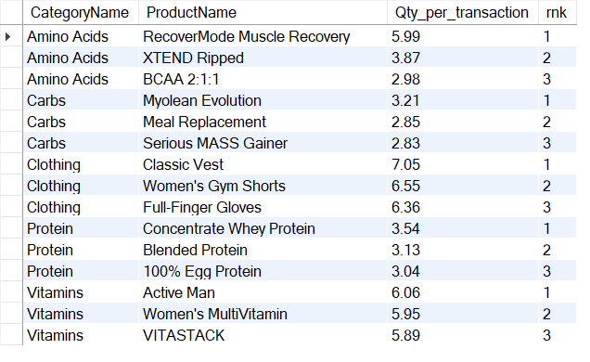
Q: Query top 3 qty per transaction of products category wise to identify fast moving products of each category.

Slide 15
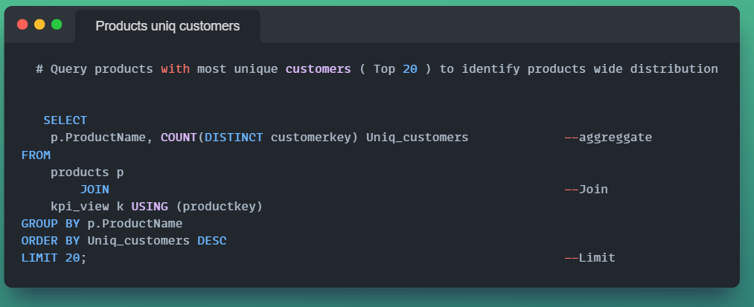
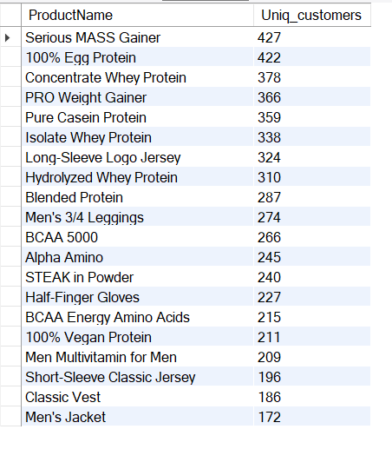
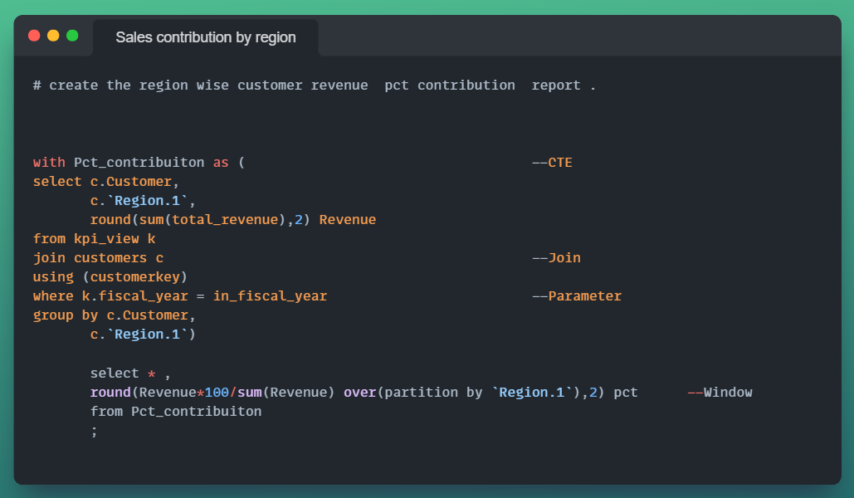
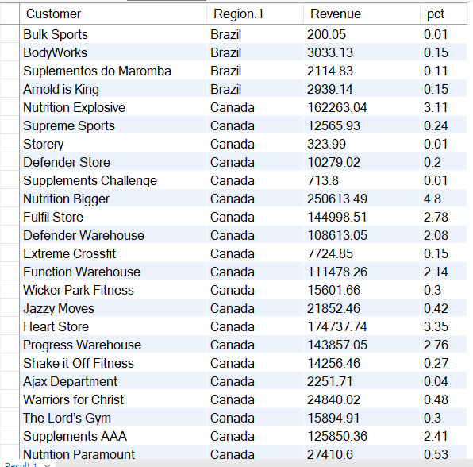
Q: Query products with most unique customers ( Top 20 ) to identify products wide distribution & query region wise sales % contribution by customers.

Slide 16
Q: Query products with most unique customers ( Top 20 ) to identify products wide distribution & query region wise sales % contribution by customers.

Slide 17
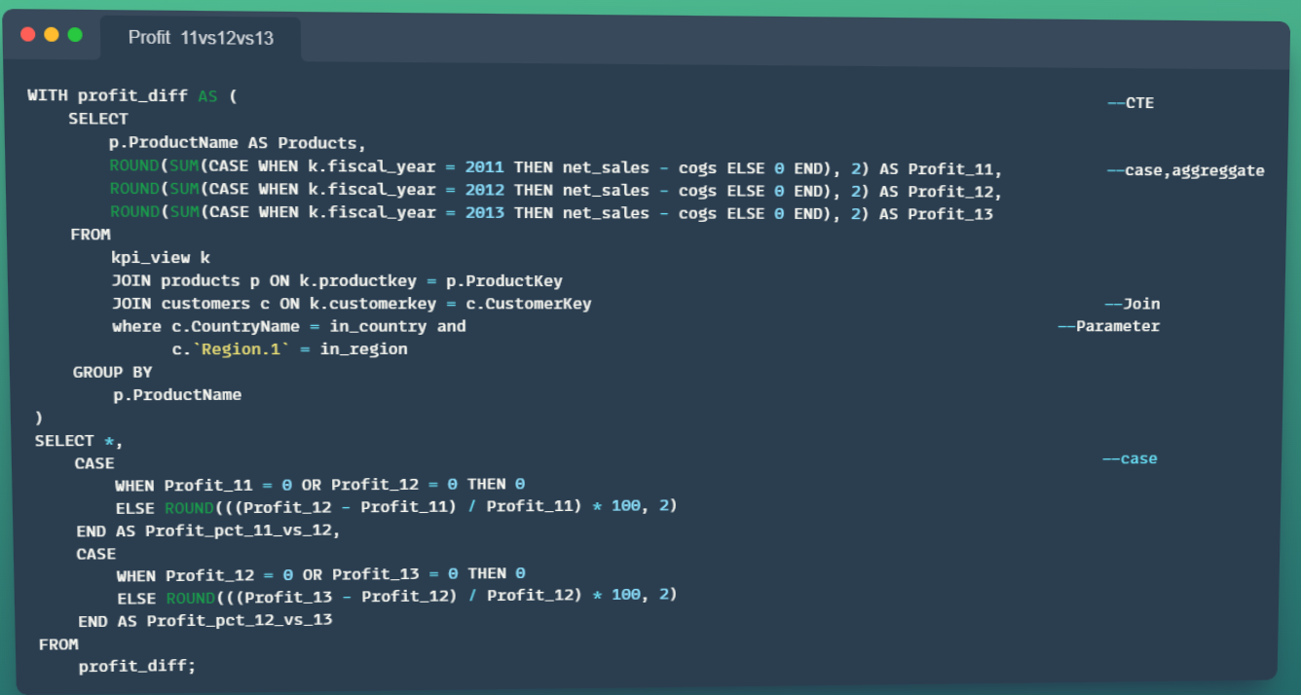
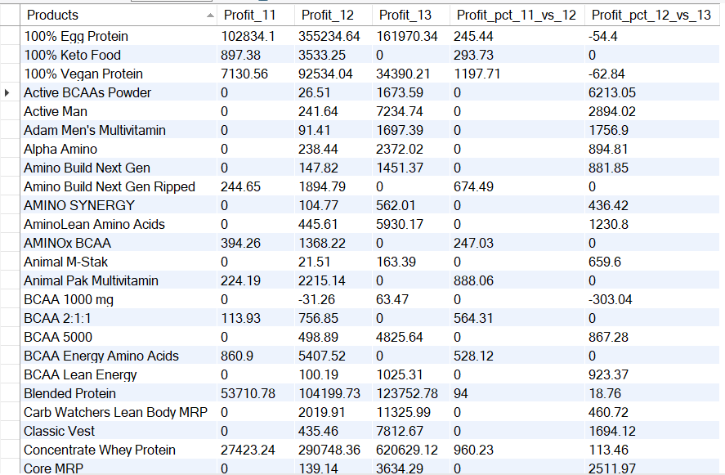
Q:Query a Product based profit report of 11 vs 12 vs 13 , create store procedure on “country” , “region” to make the report dynamic

Slide 18
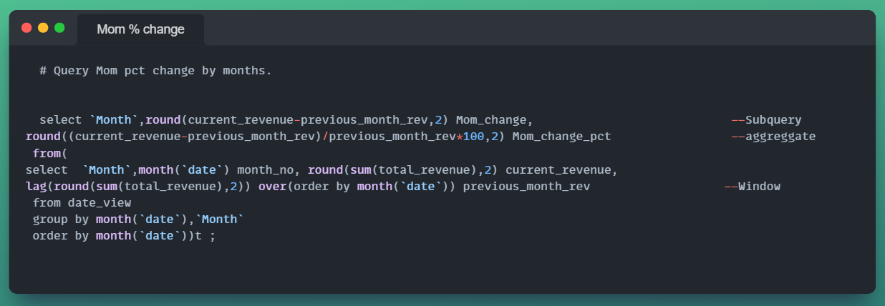
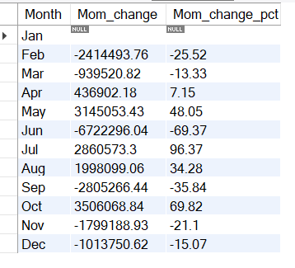
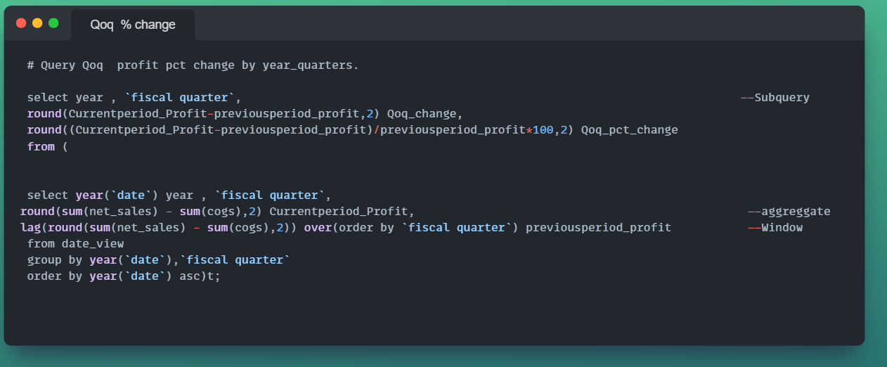
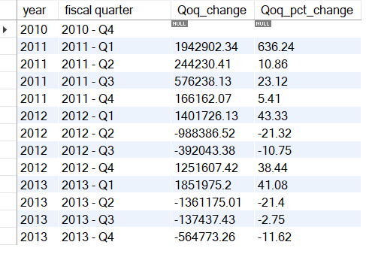
Q: Query Month over month & Quarter over quarter sales % change .

Slide 19
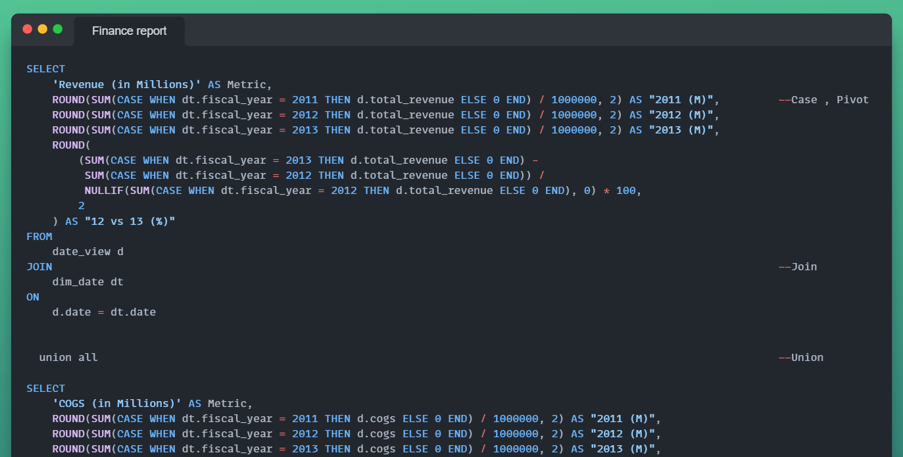
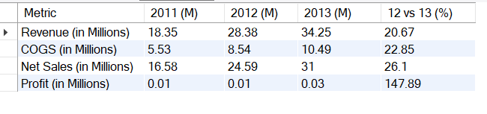
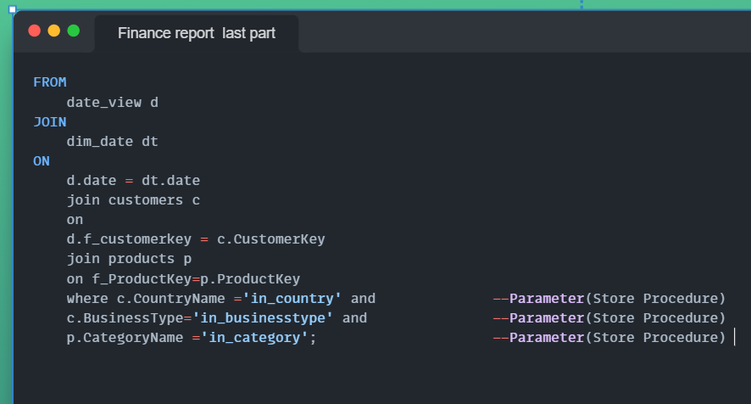
Q: Generate a finance report by year & keep the report dynamic by country ,business type , category for multiple uses .

Slide 20
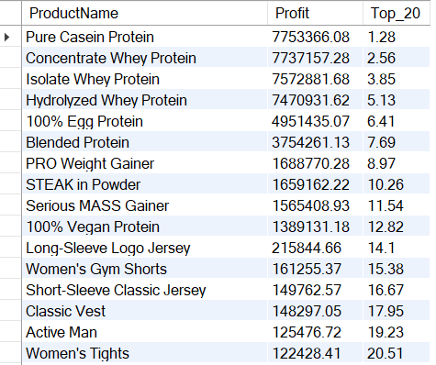
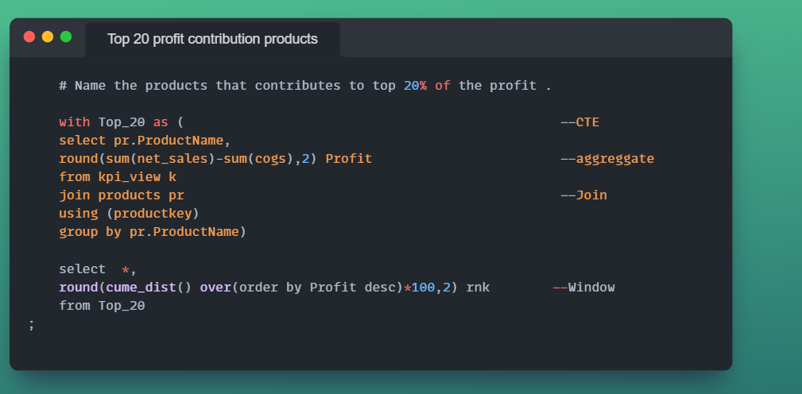

Slide 21
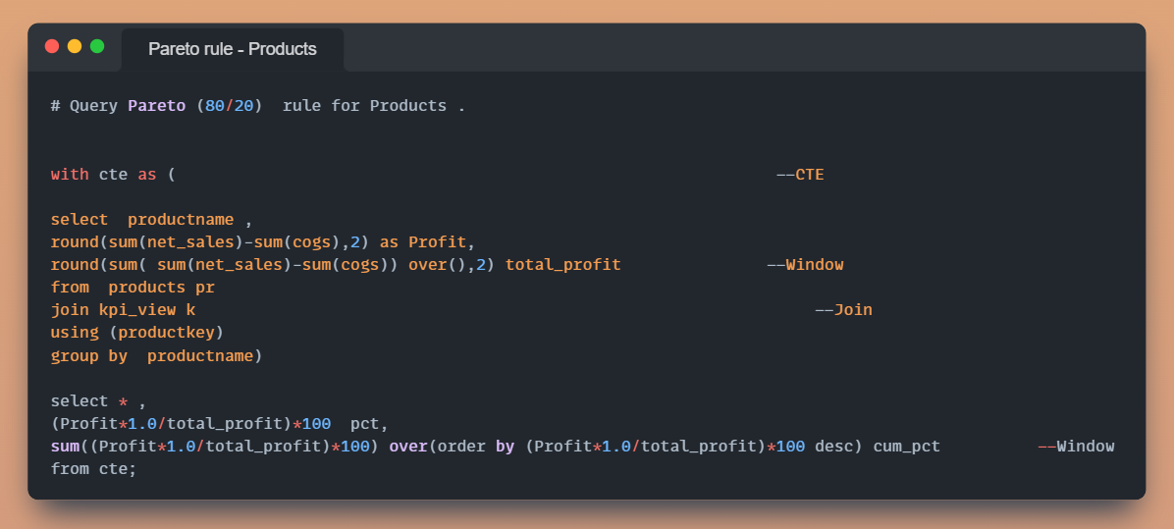



Query Pareto (80/20) rule of profit for Products & Customers .

Slide 22


Query new & repeat customer orders based on order date

Slide 23


Query running total of revenue .

